Slide 1




A
NEXT GEN EMPLOYABILITY PROGRAM
Creating a future-ready workforce
Team Members
College Name
Student Name :ANEES HUSSAIN
Student ID :513521243003
Annai Mira college of engineering and technology

Slide 2

CAPSTONE PROJECT SHOWCASE
Project Title
Building Bus Reservation System using Python and Django
Abstract | Problem Statement | Project Overview | Proposed Solution | Technology Used | Modelling & Results | Conclusion

Slide 3
Abstract
A bus reservation system comprises user interfaces for booking, a database for storing bus and route data, reservation management for seat allocation, a payment gateway for transactions, authentication for user access, and notifications for updates.
Administrative tools oversee system operations, while integration interfaces connect with external services like GPS tracking.
Source :

Slide 4
Problem Statement
The problem statement for a bus reservation system could be:
Design and implement a bus reservation system that allows users to search for available buses, select seats, make reservations, and process payments securely.
The system should maintain up-to-date information on bus schedules, seat availability, and user bookings.
Additionally, it should provide administrative tools for managing buses, routes, fares, and user accounts. Integration with external services like GPS tracking should ensure accurate real-time updates on bus locations.
The system must be user-friendly, scalable, and reliable to accommodate a large number of users and transactions effectively.
Source :

Slide 5
Project Overview
The Bus Reservation System is a web-based application designed to streamline the process of booking bus tickets.
Users can search for available buses, select seats, make reservations, and process payments securely.
The system also includes administrative tools for managing buses, routes, schedules, and user accounts.
Integration with external services such as GPS tracking ensures real-time updates on bus locations, enhancing the overall user experience.
Source :

Slide 6
Proposed Solution
The proposed solution is to develop a web-based bus reservation system featuring a user-friendly interface for booking seats, secure payment processing, real-time seat availability updates, and administrative tools for managing buses, routes, and user accounts.
Integration with external services like GPS tracking enhances the user experience by providing accurate bus location information.
Source :

Slide 7
Objectives:
The objectives of the bus reservation system are to streamline booking processes, ensure secure transactions, provide real-time updates, enhance user satisfaction, optimize operational efficiency, accommodate scalability, integrate with external services, promote sustainability, ensure accessibility, and foster innovation.
Source :

Slide 8


Technology Used
Front-end
Back-end
Source :

Slide 9
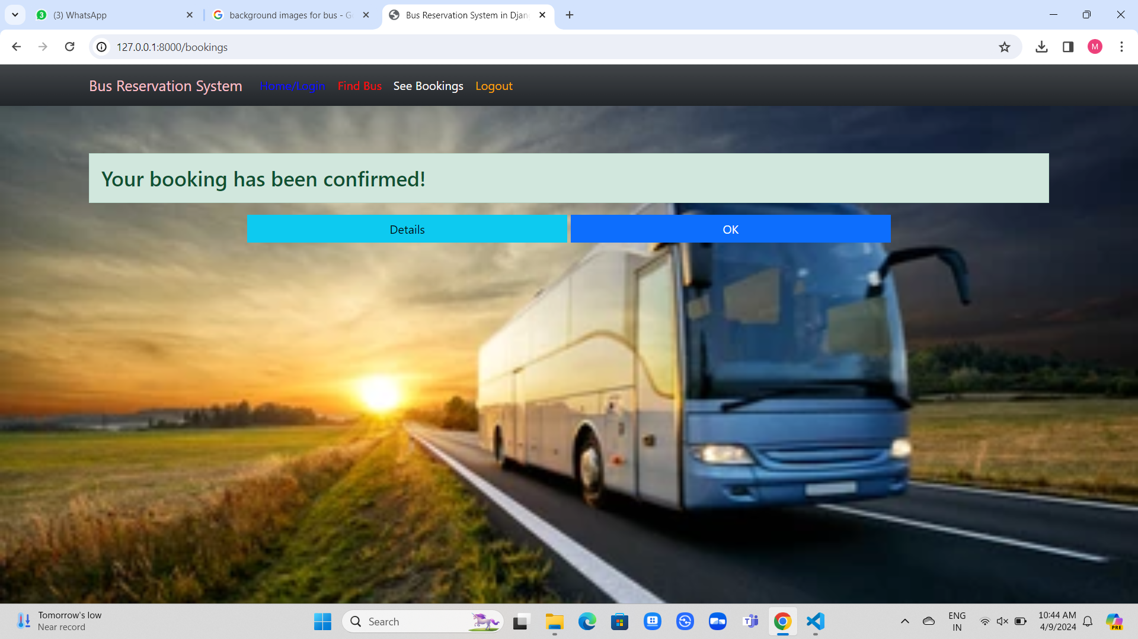
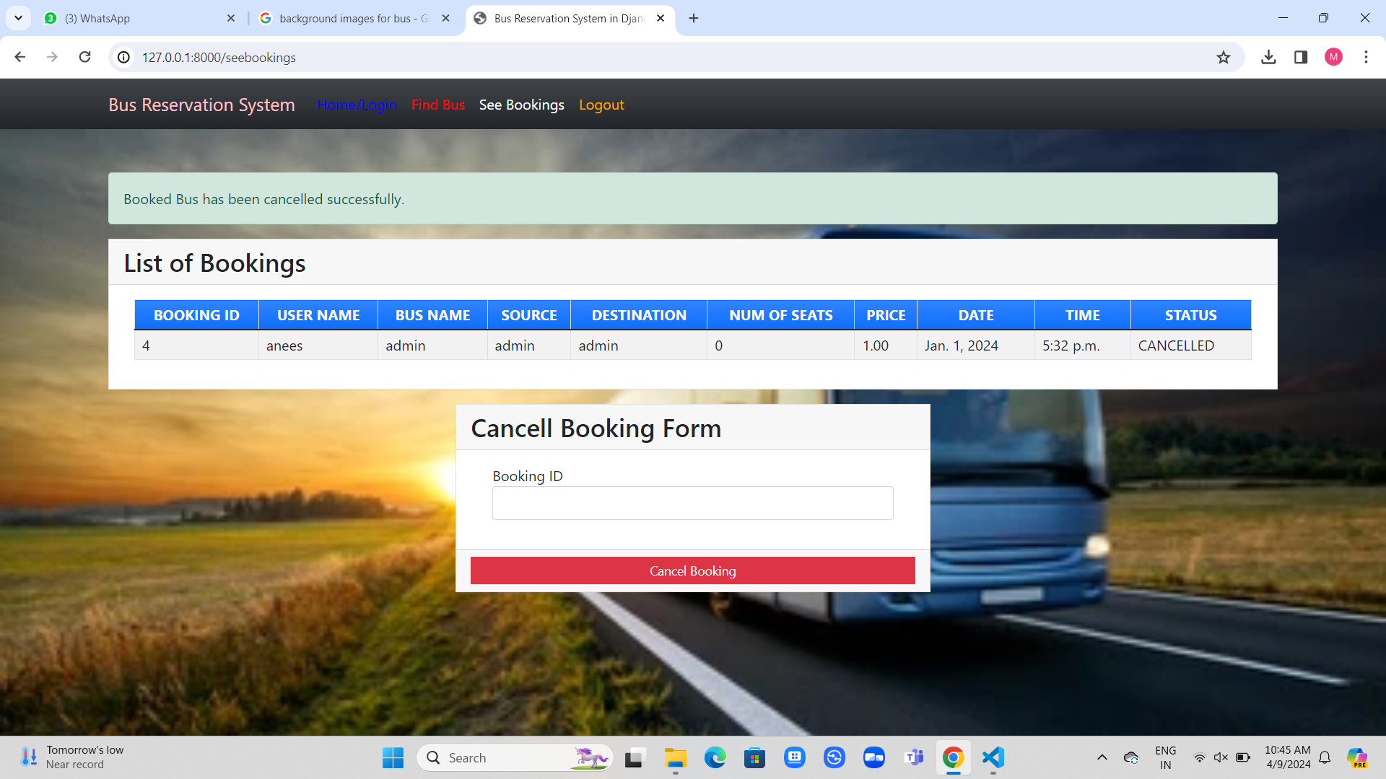
Modelling & Results

Slide 10
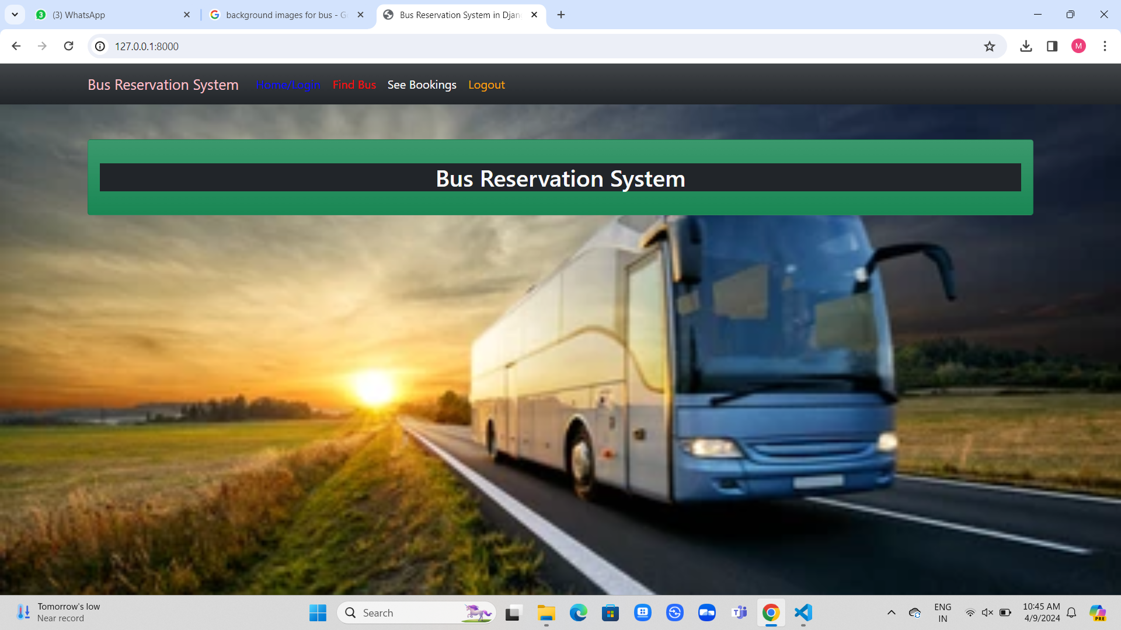
Homepage

Slide 11
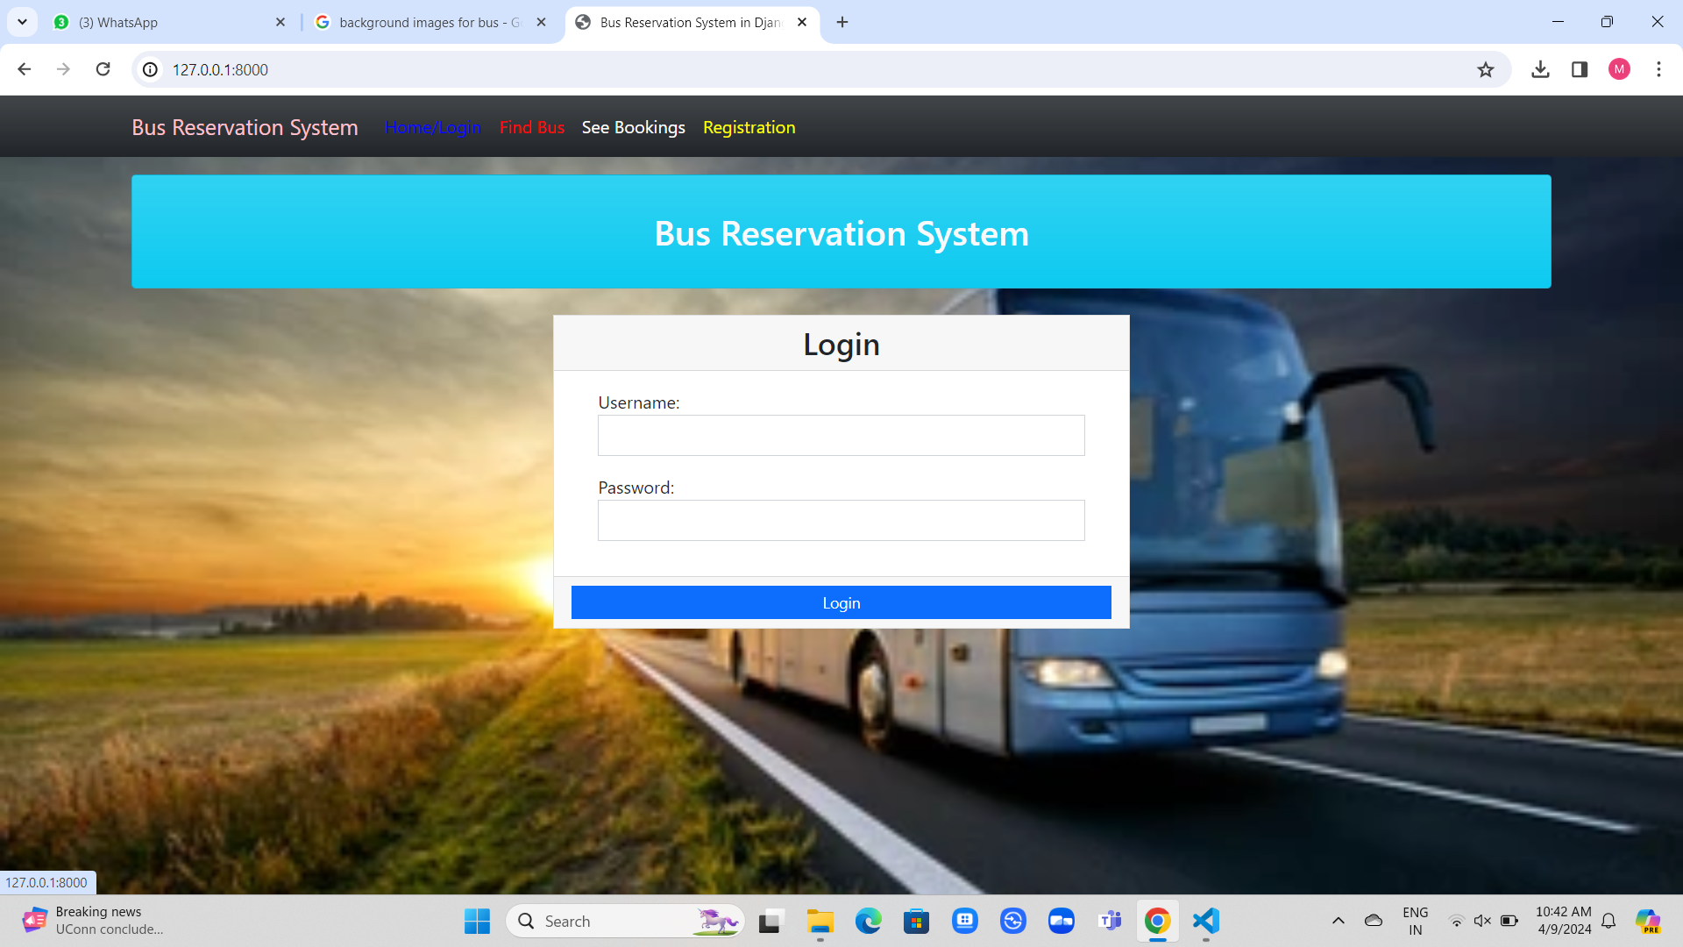
Login-Page

Slide 12
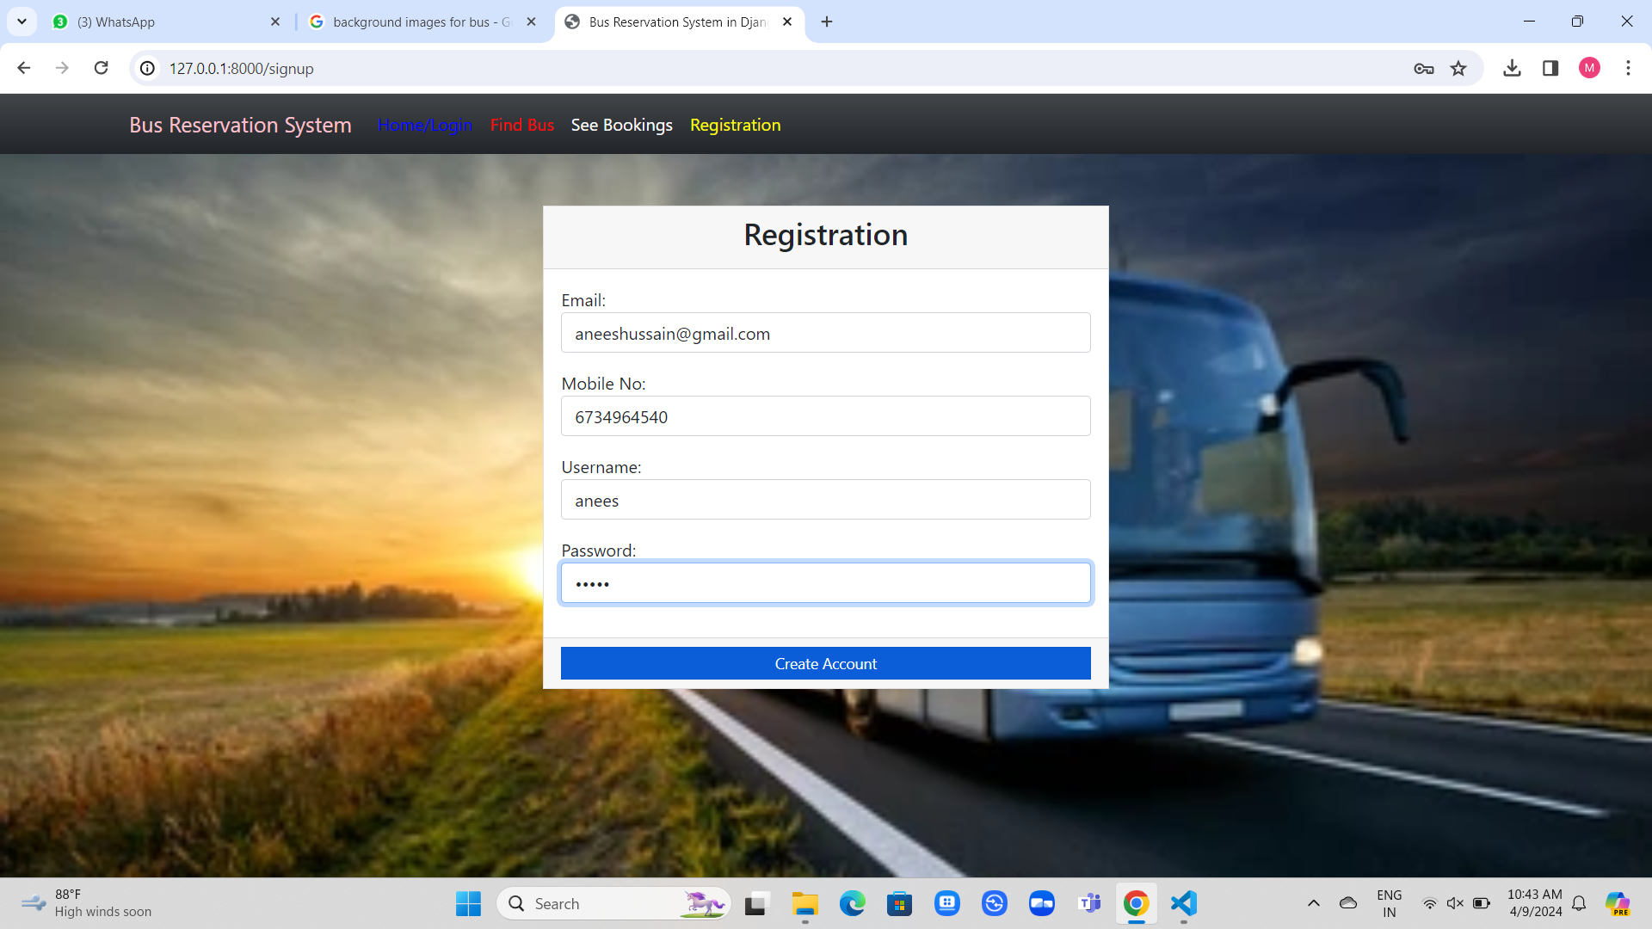
New-User Registration

Slide 13
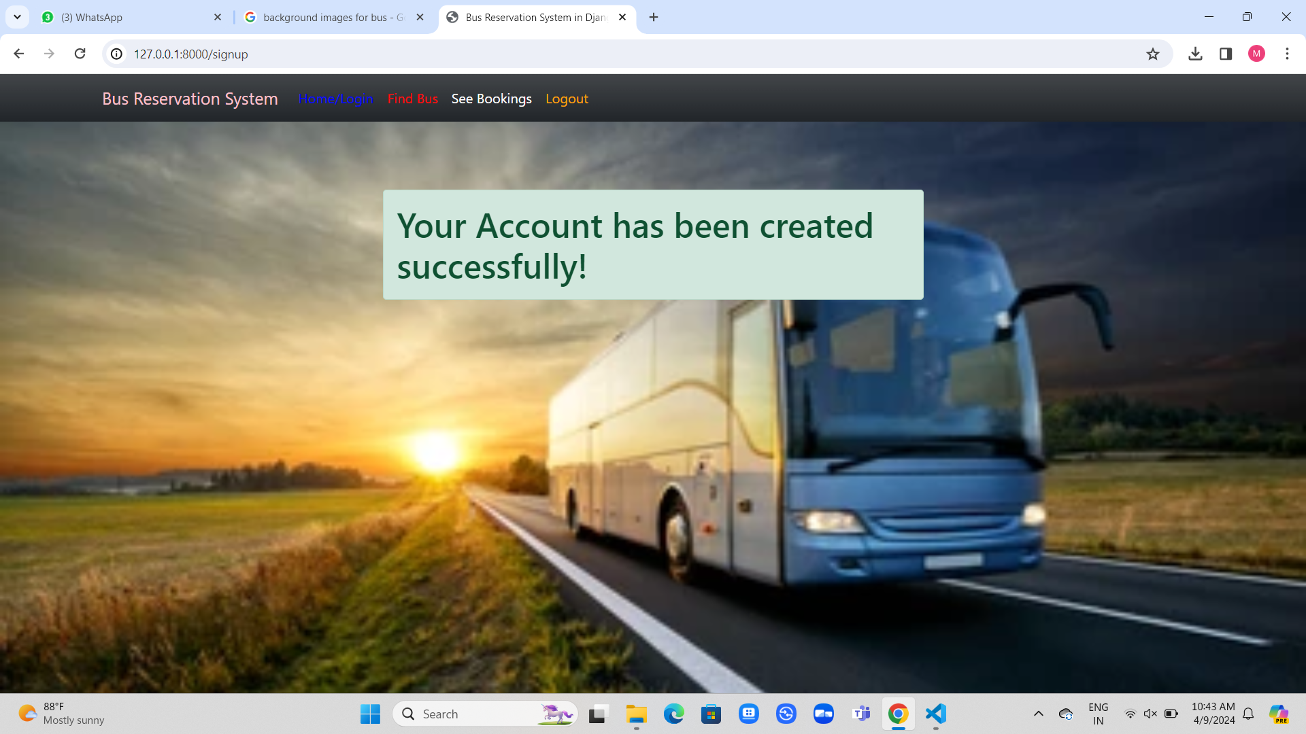
Source Page

Slide 14
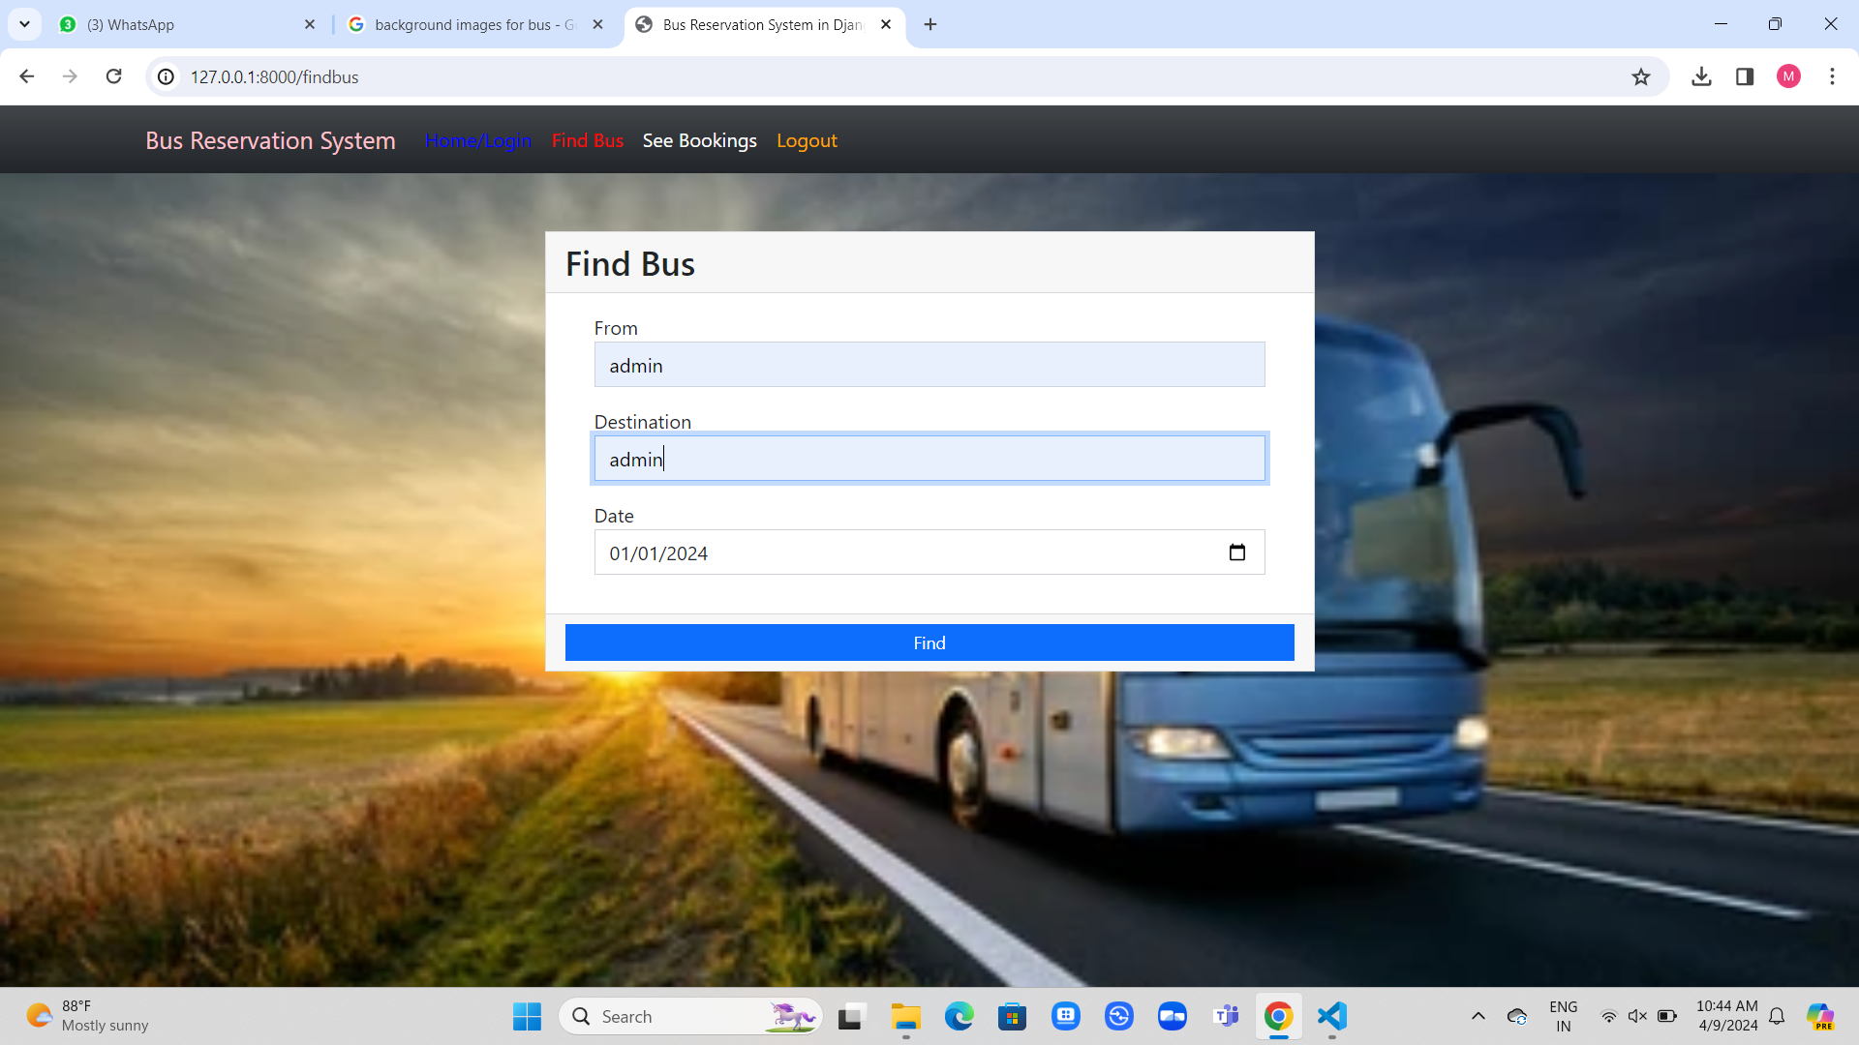
Find Bus And Booking Cancellation

Slide 15
Future Enhancements:
Future Enhancements:
1. **AI-Powered Recommendations**: Implement AI algorithms to suggest personalized travel options based on user preferences and past bookings, enhancing user satisfaction and loyalty.
2. **Blockchain Integration**: Integrate blockchain technology for secure transactions and transparent data management, ensuring trust and reliability in booking processes.
3. **Dynamic Route Optimization**: Develop algorithms to dynamically optimize bus routes based on real-time traffic data, reducing travel time and enhancing efficiency.
4. **Voice Assistant Integration**: Incorporate voice assistant technology for hands-free booking and inquiries, offering a seamless and convenient user experience.
5. **Green Initiatives**: Introduce features to promote eco-friendly travel options, such as carbon footprint tracking and incentives for choosing sustainable transportation modes.

Slide 16
Conclusion
In conclusion, the proposed bus reservation system offers a robust solution for streamlined booking processes.
With its user-friendly interface, secure transactions, and real-time updates, it promises enhanced user experiences.
Future enhancements like AI recommendations and blockchain integration aim to further elevate its functionality, ensuring continued innovation and efficiency in the transportation sector.
Source :

Slide 17
Thank You!
Notes:
Thank You !!

